Slide 1
Imitation Games
Avi Wigderson
Institute for Advanced Study

Slide 2
Plan
The original Imitation Game
Intelligence
The main idea, generalizations, speculations
Modern Imitation Games
Cryptography
Randomness
Combinatorics and number theory
Privacy
Definitions and major consequences
Conclusions

Slide 3
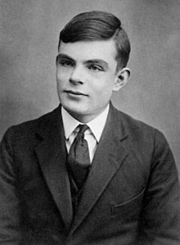
Alan Turing 1912-1954
Computer science
Computing revolution
Enigma machine
Biological modeling
Artificial Intelligence
Notes:
Morphogenesis

Slide 4
Intelligence
[Turing’50] Computing machinery and intelligence
How to study the question “can machines think?”
Define machine & think. (philosophical/ontological)
Test it! (operational/behavioral)

Slide 5



Turing’s test: the original imitation game
[Turing ‘50]
H
H
“Definition”: Robot is intelligent if the
referee makes a similar guess in both worlds
Notes:
Can we design a Robot/AI that will pass the following test.
Two worlds. The referee doesn’t know which one they are in.
Completely separated from the subject tested
Digital communication.

Slide 6
Turing’s test: the original imitation game
[Turing ‘50]
H
R
“Definition”: Robot is intelligent if the
referee makes a similar guess in both worlds
Notes:
Can we design a Robot/AI that will pass the following test.
Two worlds. The referee doesn’t know which one they are in.
Completely separated from the subject tested
Digital communication.

Slide 7
Turing’s test: the original imitation game
[Turing ‘50]
92%
93%
“Definition”: Robot is intelligent if the
referee makes a similar guess in both worlds

Slide 8

Turing’s test: the original imitation game
[Turing ‘50]
75%
74%
“Definition”: Robot is intelligent if every human referee makes a similar guess in both worlds

Slide 9

Turing’s test: the original imitation game
[Turing ‘50]
p₀
p₁
“Definition”: Robot is intelligent if
for every human referee,
p₀
≈
p₁

Slide 10
Cognition, emotions,...
Can a computer feel
Empathy, fear, pain, … ?
Conscious, self-aware, … ?
How about me? How about my dog?
What is the difference between carbon-based and silicon-based machines ?
Objective, ontological definitions may not be testable, falsifiable, have universal meaning, …
Subjective, behavioral definitions may be precise, testable, operational, useful, ..., revolutionary
xxx behave as if it feels
Notes:
Descaretes: “Cogito, ergo sum”, dictionary definitions,
Books: Asimov, Lam,
Movies: Blade Runner, Ex Machina, Her,…

Slide 11
Precise Imitation Games
- Theory of Computation
- Discrete Mathematics
Paradigm: two things are the same if they cannot be told apart by any reasonable test
Formal definitions of central notions - primary
Theorems, proofs, constructions, theories,…
Power of the Imitation Game paradigm - enable math, science, technology, policy!

Slide 12
Cryptography

Slide 13
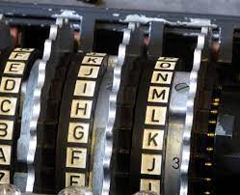

Encryption: the first 2000 years
Enc(ATTACK) = XQQXZH
Enc(RETREAT) = OBQOBXQ
Caesar’s cipher
Enigma machine
Is Enc secure?

Slide 14
Secure encryption
[Goldwasser-Micali ’81]
Enc(m₀)
Enc(m₁)
Algorithm A
Algorithm A
p₀
p₁
Definition: Enc is secure if for every m₀ & m₁
and for every efficient algorithm,
p₀
≈
p₁
Theory: Shooting for the moon (and getting there!) Defining secret. Shows Enc must be probabilistic!
Possible! Based on mathematical hardness assumption

Slide 15
Modern cryptography last 4 decades
Public-key Encryption
On-line shopping
Contract signing
Secret exchange
Zero-knowledge proofs
Internet elections
Poker on telephone
Blockchains & digital currency
………
Everything (w/out physical implements!)
Is a given
protocol secure?

Slide 16
(e.g.) Secure elections
[Yao’86, Goldreich
-Micali-W ’87]
Government
Internet
Protocol
Algorithm A
Algorithm A
p₀
p₁
Definition: Protocol is secure if for every efficient algorithm, and every player
p₀
≈
p₁

Slide 17
Secure elections
[Yao’86, Goldreich
-Micali-W ’87]
Government
Internet
Protocol
Algorithm A
Algorithm A
p₀
p₁
Definition: Protocol is secure if for every efficient algorithm, and every player
p₀
≈
p₁

Slide 18
Secure elections
[Yao’86, Goldreich
-Micali-W ’87]
Government
Internet
Protocol
Algorithm A
Algorithm A
p₀
p₁
Definition: Protocol is secure if for every efficient algorithm, and every subset of players,
p₀
≈
p₁
Theory: Crypto! Zero-Knowledge, Secure protocol design for any problem, under simple assumptions
Practice: Internet security, shopping, blockchains,…

Slide 19
Randomness

Slide 20

The amazing utility of randomness
Nature seems to supply us perfect randomness
which we use for numerous applications
Sampling
Scientific experiments & simulations
Probabilistic algorithms
Cryptography
Game theory
Gambling
…
Is this power real?
Unbiased, independent bits
Where are the random bits from?

Slide 21
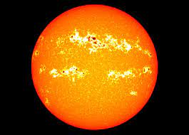
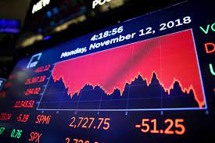



Universe has:
Applications
- Perfect randomness
Weak random sources
Biased, dependent bits
- No randomness
Everything!
??
??

Slide 22
Computational pseudo-randomness
[Blum-Micali ’81
Yao’82]
Algorithm A
Algorithm A
p₀
p₁
Definition: is pseudo-random
If for every efficient algorithm,
p₀
≈
p₁
Theory: Composition, Amplification,
Hardness vs. Randomness paradigm
Practice: Pseudo-random generators, Crypto

Slide 23
Universe has:
Applications
- Perfect randomness
Weak random sources
Biased, dependent bits
- No randomness
Everything!
all prob algorithms
Extractor theory
[B,SV,NZ,T,…,GUV,DW,…]
purifying randomness
all prob algorithms
Hardness vs. Randomness
[BM,Y,…NW,IW,…]
Every fast prob alg has a deterministic counterpart
Major theories
Unexpected benefits
Assuming “P≠NP”: there
are hard problems

Slide 24
Structural pseudo-randomness
(discrete math, number theory,…)
[Ramsey ’30] “Every large enough system must
have some structure”

Slide 25
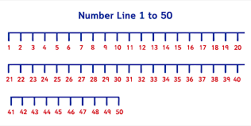
Periodic sequences
1 2 8 13 19 21 28 33
2 3 5 7 11 13 17 19 23 29 31 37
Which subsets contains long periodic sequences?
[Szemeredi ’75] All “dense” subsets do!
[Green-Tao ’04] The primes numbers do!
[Easy] Random subsets do!
Which subsets “look” random?
[Szemeredi ’75] Every “dense” network does!!

Slide 26
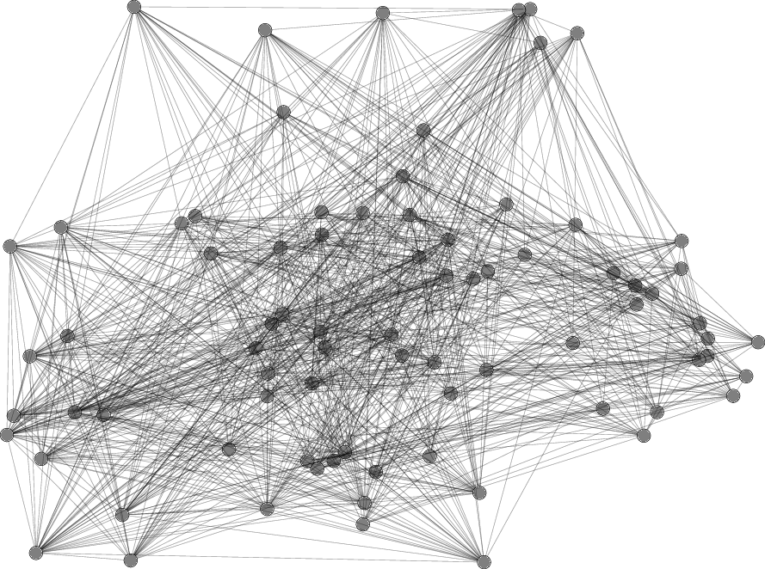
Networks, Clusters, Bonds
p
p = bond: fraction of
actual connections
between clusters,
out of all possible
Roads, Internet, Facebook,...

Slide 27
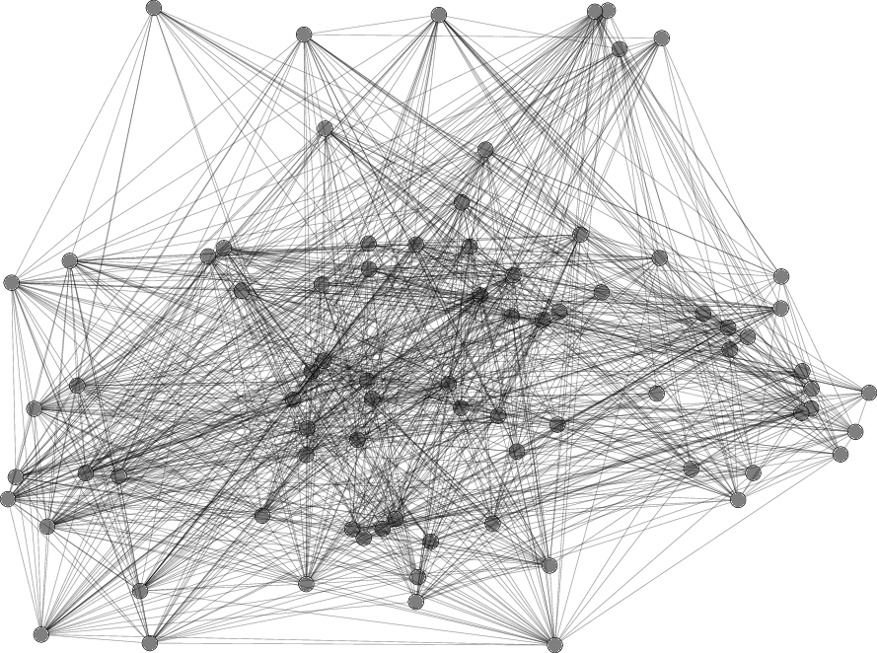
Bond-similarity of networks
[Szemeredi’75]
22%
23%
N₀
N₁
Definition: N₀ & N₁ are bond-similar if
every two communities are equally bonded
p₀
≈
p₁

Slide 28
Bond-similarity of networks
[Szemeredi’75]
p₀
p₁
N₀
N₁
Definition: N₀ & N₁ are bond-similar if
every two communities are equally bonded
p₀
≈
p₁

Slide 29
Regularity
[Szemeredi’75]
N₀
Szemeredi’s Regularity Lemma:
Every network is bond-similar to a random network
Proof: Every network has a tiny model
Bonds between few communities determine all bonds

Slide 30
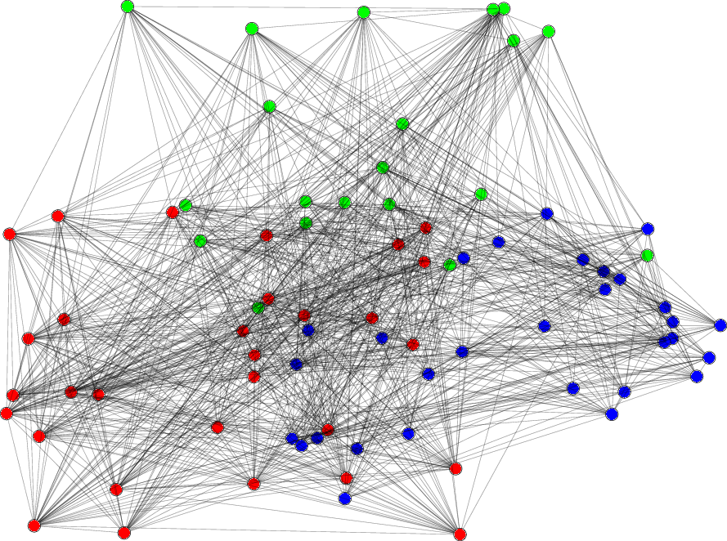
Regularity
[Szemeredi’75]
0.8 | 0.1 | 0.4
0.1 | 0.3 | 0.3
0.4 | 0.3 | 0.2
N₀
Szemeredi’s Regularity Lemma:
Every network is bond-similar to a random network
Proof: Every network has a tiny model
Bonds between few communities determine all bonds

Slide 31
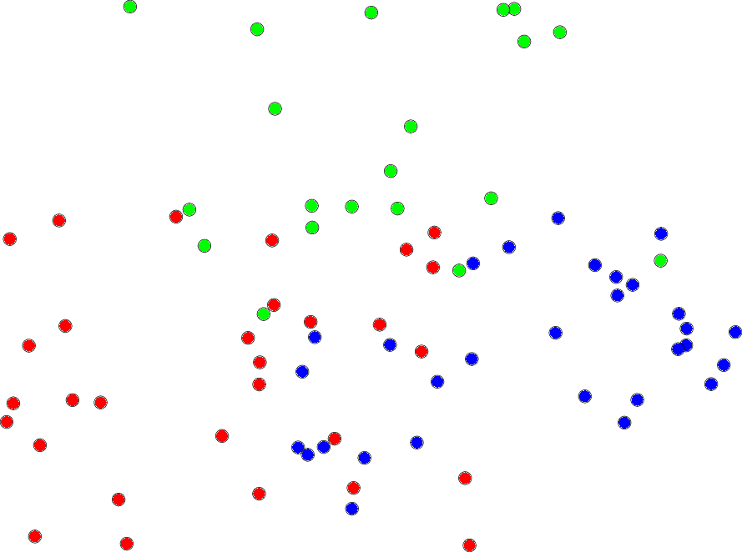
Regularity
[Szemeredi’75]
0.8 | 0.1 | 0.4
0.1 | 0.3 | 0.3
0.4 | 0.3 | 0.2
N₀
random
Szemeredi’s Regularity Lemma:
Every network is bond-similar to a random network
Proof: Every network has a tiny model
Bonds between few communities determine all bonds

Slide 32
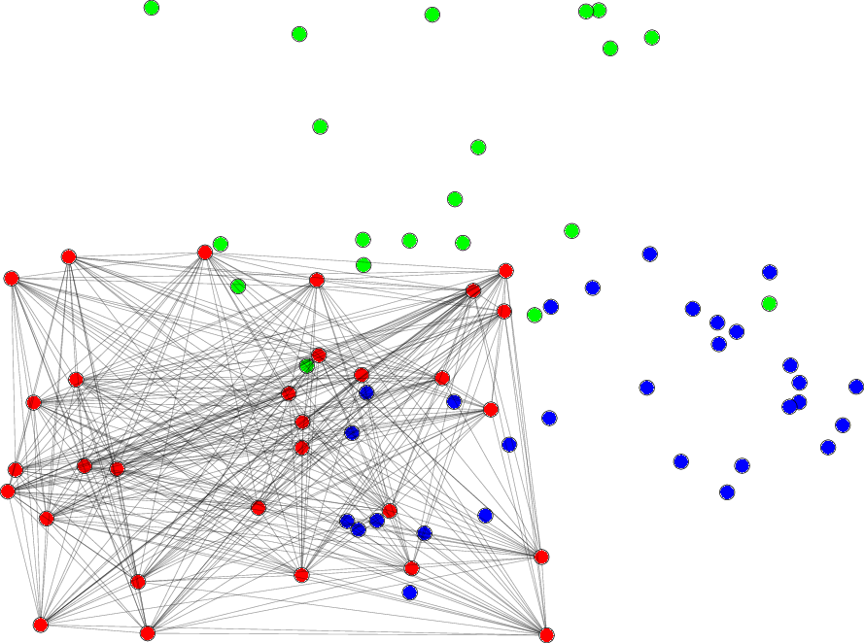
Regularity
[Szemeredi’75]
0.8 | 0.1 | 0.4
0.1 | 0.3 | 0.3
0.4 | 0.3 | 0.2
N₀
random
Szemeredi’s Regularity Lemma:
Every network is bond-similar to a random network
Proof: Every network has a tiny model
Bonds between few communities determine all bonds

Slide 33
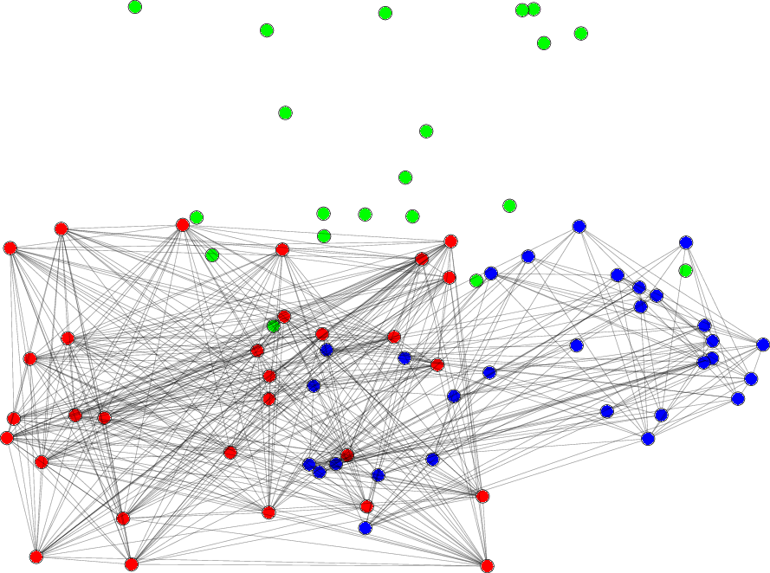
Regularity
[Szemeredi’75]
0.8 | 0.1 | 0.4
0.1 | 0.3 | 0.3
0.4 | 0.3 | 0.2
N₀
random
Szemeredi’s Regularity Lemma:
Every network is bond-similar to a random network
Proof: Every network has a tiny model
Bonds between few communities determine all bonds

Slide 34
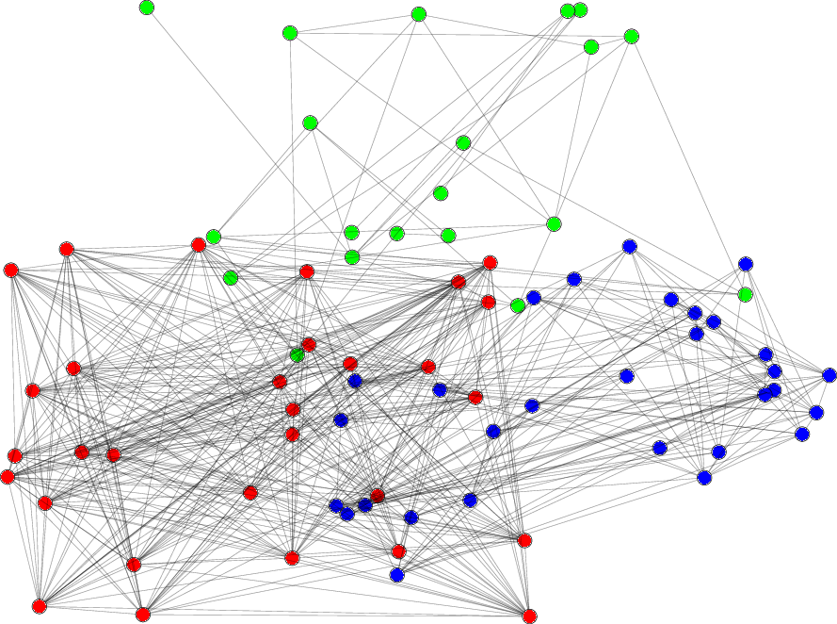
Regularity
[Szemeredi’75]
0.8 | 0.1 | 0.4
0.1 | 0.3 | 0.3
0.4 | 0.3 | 0.2
N₀
random
Szemeredi’s Regularity Lemma:
Every network is bond-similar to a random network
Proof: Every network has a tiny model
Bonds between few communities determine all bonds

Slide 35
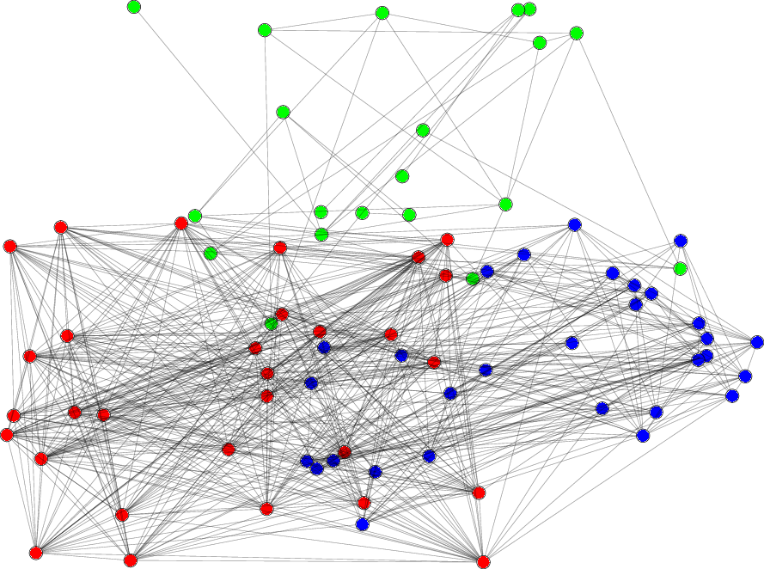
Regularity
[Szemeredi’75]
0.8 | 0.1 | 0.4
0.1 | 0.3 | 0.3
0.4 | 0.3 | 0.2
N₀
random
Szemeredi’s Regularity Lemma:
Every network is bond-similar to a random network
Proof: Every network has a tiny model
Bonds between few communities determine all bonds

Slide 36
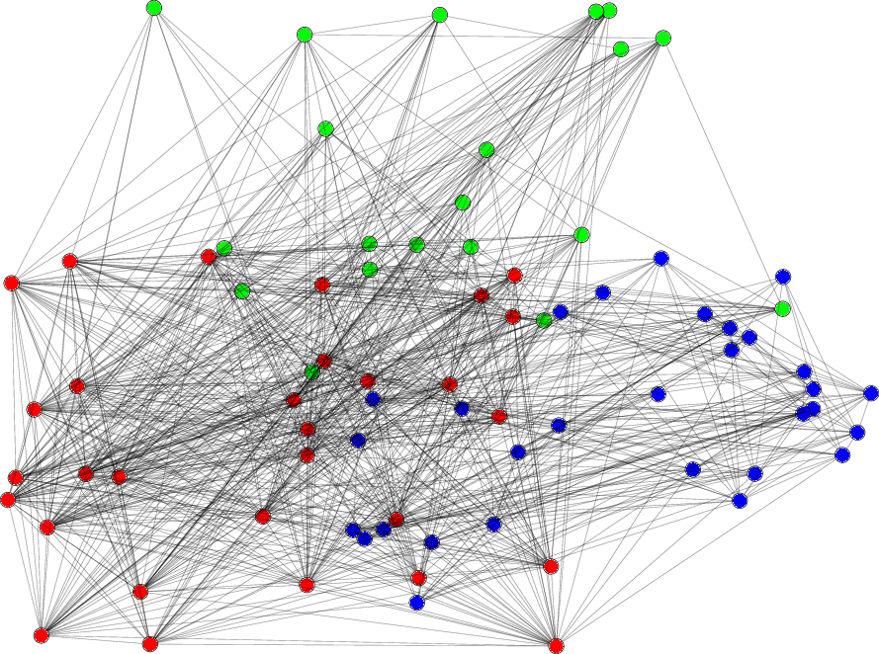
Regularity
[Szemeredi’75]
0.8 | 0.1 | 0.4
0.1 | 0.3 | 0.3
0.4 | 0.3 | 0.2
N₀
random
Szemeredi’s Regularity Lemma:
Every network is bond-similar to a random network
Proof: Every network has a tiny model
Bonds between few communities determine all bonds

Slide 37
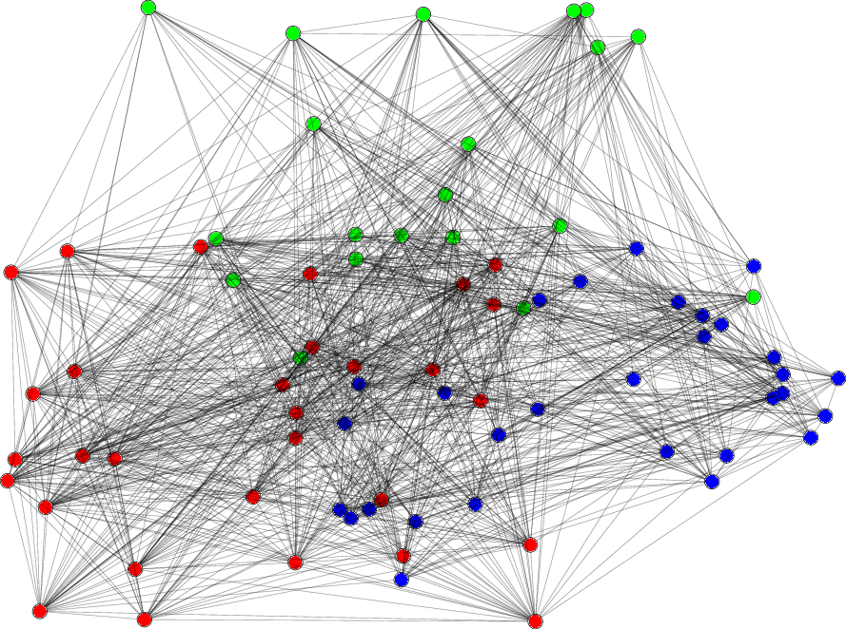
Regularity
[Szemeredi’75]
0.8 | 0.1 | 0.4
0.1 | 0.3 | 0.3
0.4 | 0.3 | 0.2
N₀
random
Szemeredi’s Regularity Lemma:
Every network is bond-similar to a random network
Proof: Every network has a tiny model
Bonds between few communities determine all bonds

Slide 38
Regularity Galore
Dense graphs, sequences “look” random
True for every structure, any set of tests!
[Szemeredi, Thomasson, Chung-Graham-Wilson, Green-Tao-Ziegler, Gowers] Transference principle
[Impagliazzo, Reingold-Trevisan-Tulisani-Vadhan] Dense model theorem
Structure vs. Randomness dichotomy
Discrete Math - PDEs
Number Theory - Ergodic Theory
Complexity Theory - Analysis
……

Slide 39
Privacy

Slide 40





Privacy versus Utility
Why should I
- Participate?
-Tell the truth?
Welfare gaps
Urban planning
Drug/treatment
Dijkgraaf
Data
analysts
- Restrict
queries
- Filter
answers
filter
Database D: Many
individual records, e.g.
census/medical data

Slide 41
Differential Privacy
[Dwork-McSherry-Nissim-Smith’06]
Dijkgraaf
D₀
D₁
filter
filter
Query Q
Query Q
p₀
p₁
Definition: A filter is differentially private if for every adjacent D₀ & D₁ and every legal query,
p₀
≈
p₁
Theory: Composition, many queries, higher accuracy,
resistance to future knowledge acquisition,..
Practice: US Census 2020, Google/Facebook/Amazon

Slide 42


Adaptive data analysis
[Dwork-Feldman-Hardt-Pitassi-Reingold-Roth’14,15,…]
Data
expensive!
Adaptively:
- Tune parameters
- Form hypotheses
- Generate queries
sample
filter
- Data reuse
- Overfitting
- No generalization
Crisis: “Why most
published research
findings are wrong”
Ioannidis’05 PLoSMed
Science/ML
Theorem: Using a differentially private filter can prevent overfitting, ensure statistical validity and generalization, despite data reuse and adaptivity!

Slide 43
Summary
Things are identical unless you can tell them apart (eg diamonds, Picassos, news… real/fake)
Behavioral, “subjective” definitions (like Imitation Games) are extremely powerful. May be useful in philosophical and operational understanding other fundamental notions.
ToC is a modeling science, essentially tuned to the underlying process and its resources.
Definitions of central notions are primary - enable math, science, technology, policy!

Slide 44
Book ad
- Published by Princeton University Press
- Free (forever) on my website
- Comments welcome!

